Slide 1
A View of Romanian Non-Profit Organizations in the United States
Alex Trufinescu, The American-Romanian Cultural Society
August 2020 – Seattle, Washington
Notes:
ARCS Copyright 2020

Slide 2
Agenda
Methodology – Sources and approaches to research
Distribution of Romanian Population in the US
Distribution of Romanian Organizations in the US
Religious Affiliation of Romanian Organizations
Financial Analysis of Romanian Organizations
Focus of Romanian Organizations – Based on Official Names
Conclusion

Slide 3
Methodology
2018 American Community Survey (conducted by US Census) – Used for researching Romanian population by state
IRS non-profit database – Used for organization titles, location, religious affiliation, and financial information
  Organizations must file through IRS and have certain legal requirments, so most accurate and up-to-date
Key word search – “Romania” and “Romanian”
  Possible undercount of organizations

Slide 4
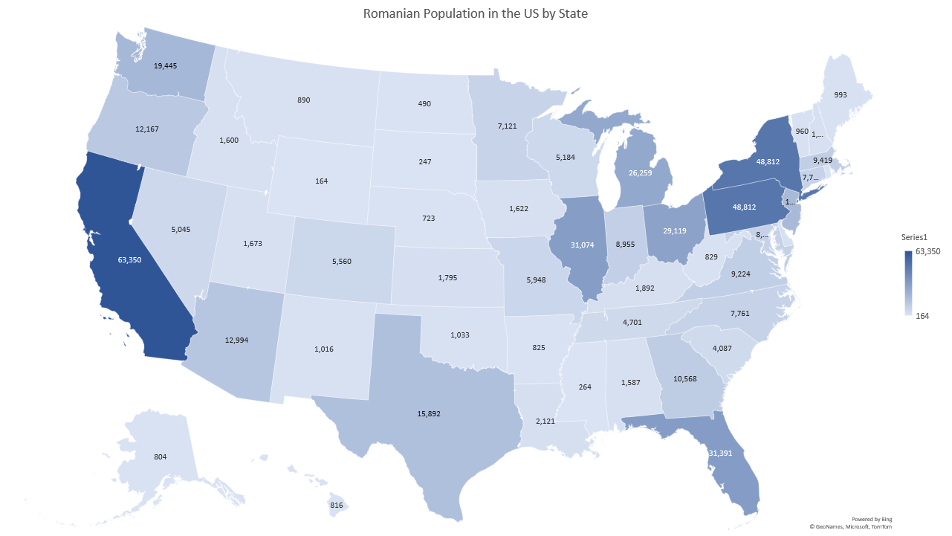
Romanian Population

Slide 5
Analysis
Significant presence in:
  Great Lakes
    Illinois, Ohio, Michigan, Indiana…
  Mid-Atlantic
    Pennsylvania, New York…
  West Coast
    California, Washington, Arizona, Oregon…
Notable presence in:
  New England
    Massachusetts…
  The South
    Florida, Texas, Georgia, Virginia…
Negligible presence in:
  Midwest
  Non-continental US

Slide 6
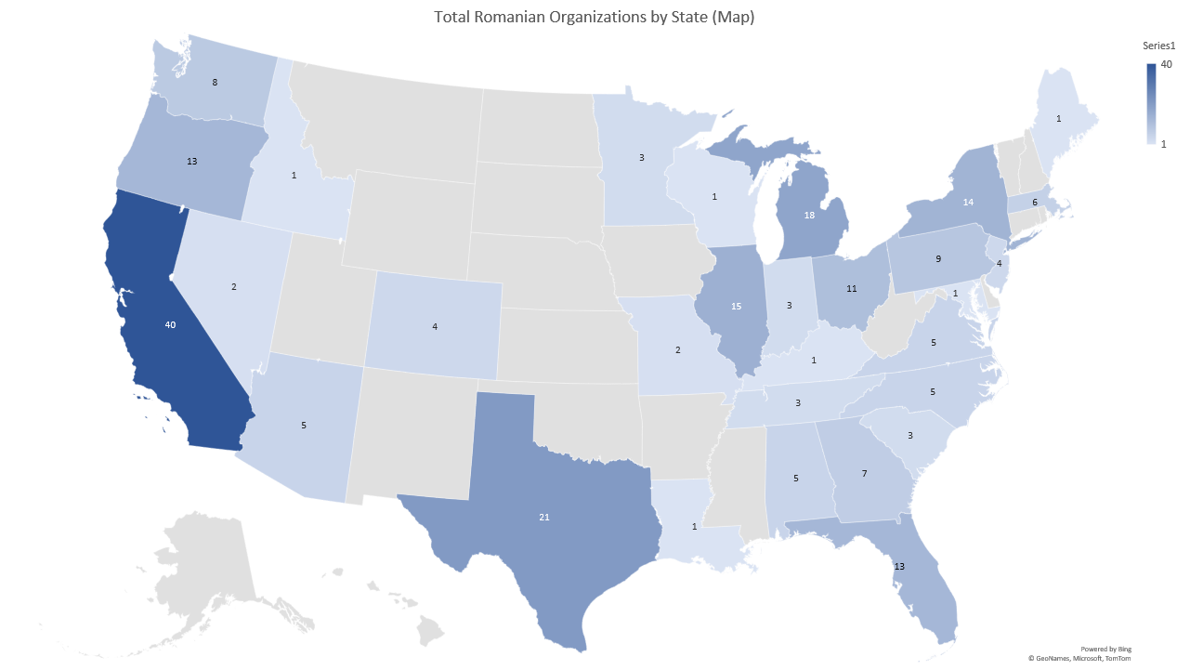
Romanian Organizations

Slide 7
Analysis
Similar pattern to Romanian population by state
Significant presence in:
  Great Lakes
    Notable States: Illinois, Ohio, Michigan
  Mid-Atlantic
    Notable States: Pennsylvania, New York
  West Coast
    Notable States: California, Washington, Oregon
Notable presence in:
  New England
    Notable States: Massachusetts
  The South
    Notable States: Florida, Texas, Georgia
Negligible presence in:
  Midwest
  Non-continental US

Slide 8
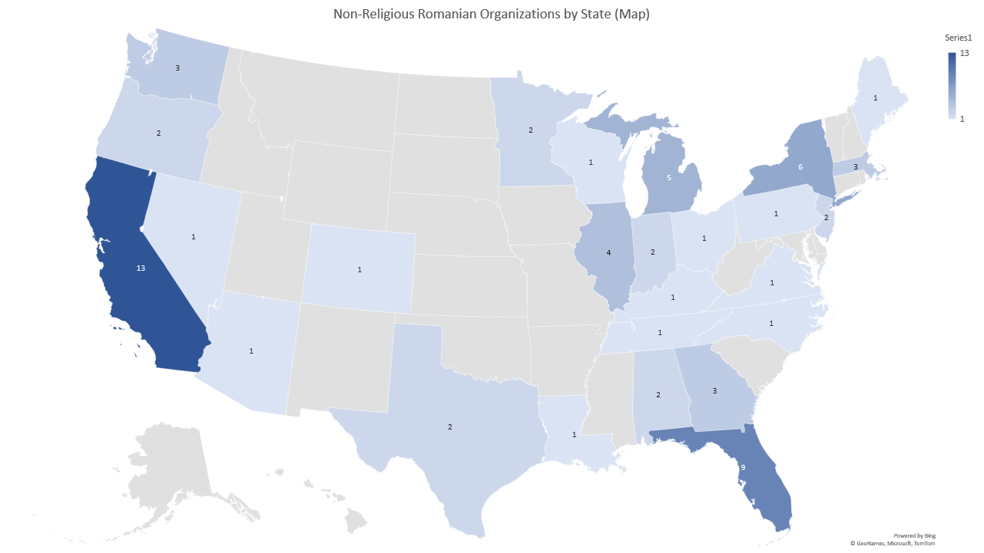
Romanian Organizations

Slide 9
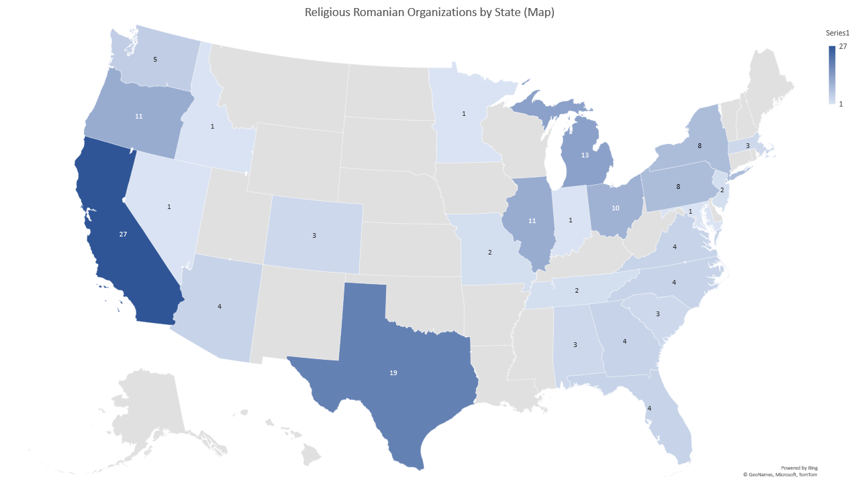
Romanian Organizations

Slide 10
Analysis
Greater amount of religious than non-religious organizations (overall and in most individual states)
  68% vs 32%
More of the religious organizations are concentrated in the Mid-Atlantic and Great Lakes regions compared to distribution of non-religious organizations
  Less recent immigration in those regions

Slide 12
Analysis
“Financially strong” defined: Gross receipt greater than $50,000
  “Gross receipt” defined: Total money raised in a fiscal year w/out expenses subtracted
Gross receipt amount taken from most recent fiscal year reported – 2018, 2019
Romanian American Foundation (RAF) has the highest gross receipt and is not included in the table
  $67,550,251 gross receipt (30 times the gross receipt amount of the Romanian American Community Center, which has the second highest gross receipt)
  RAF is a successor of the Romanian-American Enterprise Fund, founded by Congress and given federal funding

Slide 13
Analysis (Part 2)
Beyond the definition of “financially strong” – several organizations had expenses larger than gross receipts

Slide 14
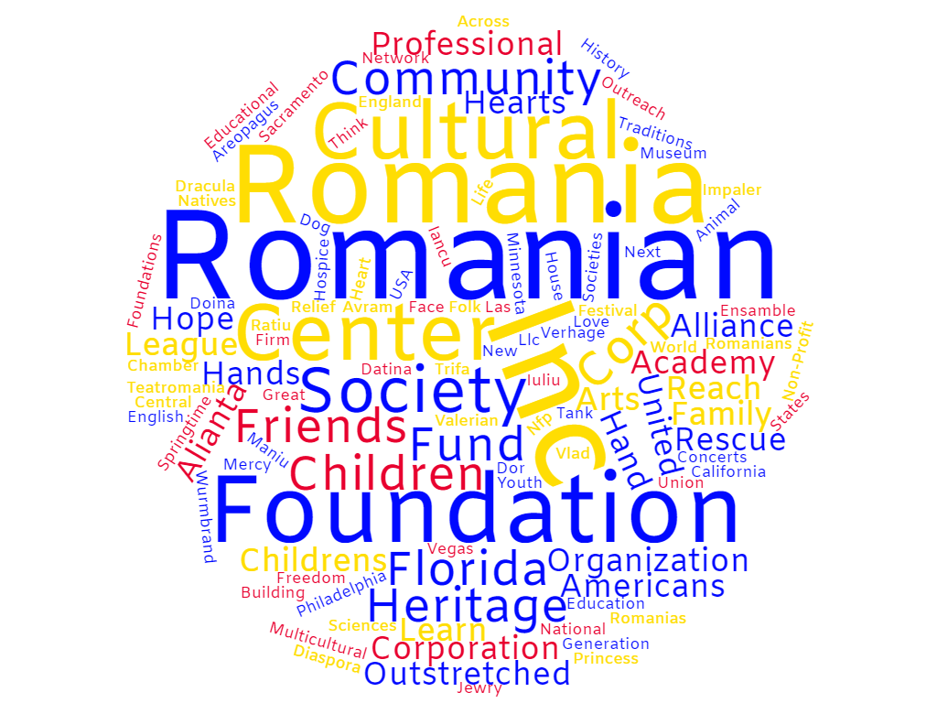
Titular Words of Non-religious Romanian Organizations - Word Cloud

Slide 15
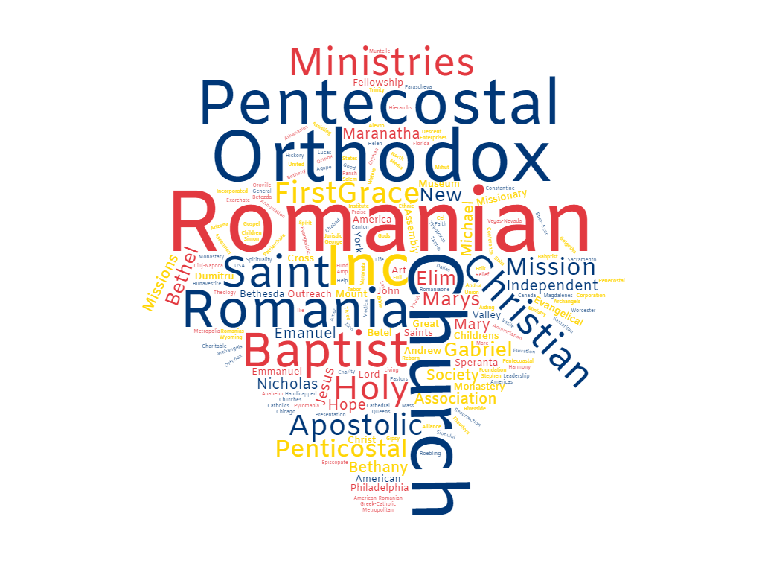
Titular Words of Religious Romanian Organizations - Word Cloud

Slide 16
Analysis
Greater diversity in words appearing in religious organization titles
Non-religious organizations placing emphasis on the general idea of “culture,” “heritage,” “society,” and other related concepts
Religious organizations placing emphasis on denominations of organizations – “Pentecostal”/“Penticostal,” “Orthodox,” “Baptist,” “Apostolic,” etc.

Slide 17
Conclusion
Romanian organizations concentrated in specific regions
Romanian community connected more by religion than culture
Relatively small number of financially strong non-religious organizations
  Perhaps because more recently established

